Slide 1

IADT Project Presentation
SIDDHARTHA | AKASH | BALPREET | GOWTHAM

Slide 2

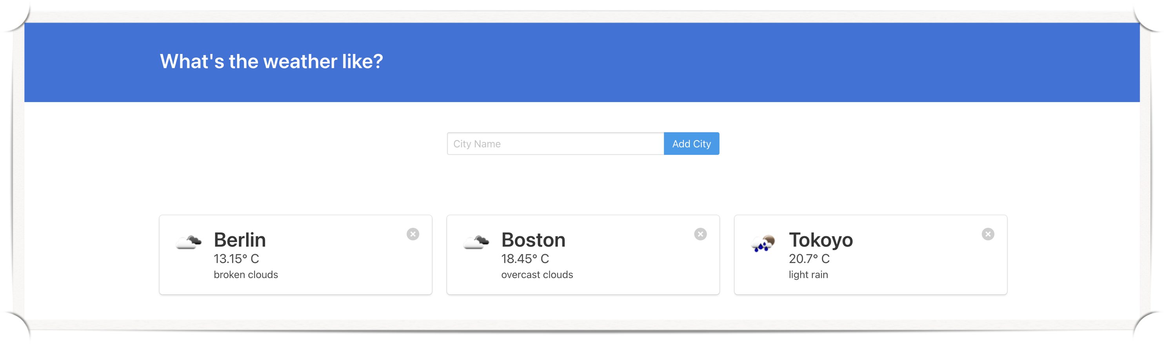
OVERview
A web-application to check weather of a city
Architecture includes a cloud and on-premise deployment
Cloud platform : AWS

Slide 3

TOoLS Used

Slide 4

TOoLS Used

Slide 5

TOoLS Used

Slide 6

TOoLS Used

Slide 7

TOoLS Used

Slide 8

TOoLS Used

Slide 9

TOoLS Used

Slide 10

TOoLS Used

Slide 11
Demonstration

